Slide 1
Designing a Learning System

Slide 2
DESIGNING A LEARNING SYSTEM
Choosing the Training Experience
The type of training experience available can have a significant impact on success or failure of the learner.
One key attribute is whether the training experience provides direct or indirect feedback regarding the choices made by the performance system.
For example, in learning to play checkers, the system might learn from direct training examples consisting of individual checkers board states and the correct move for each. Alternatively, it might have available only indirect information consisting of the move sequences and final outcomes of various games played.
Here the learner faces an additional problem of credit assignment, or determining the degree to which each move in the sequence deserves credit or blame for the final outcome.
A second important attribute of the training experience is the degree to which the learner controls the sequence of training examples.
For example, the learner might rely on the teacher to select informative board states and to provide the correct move for each. Alternatively, the learner might itself propose board states that it finds particularly confusing and ask the teacher for the correct move.
A third important attribute of the training experience is how well it represents the distribution of examples over which the final system performance P must be measured.

Slide 3
DESIGNING A LEARNING SYSTEM
We now have a fully specified learning task.
A checkers learning problem:
Task T: playing checkers
Performance measure P: Percent of games won in the world tournament
Training experience E: games played against itself
In order to complete the design of the learning system, we must now choose
1. the exact type of knowledge to be learned
2. a representation for this target knowledge
3. a learning mechanism

Slide 4
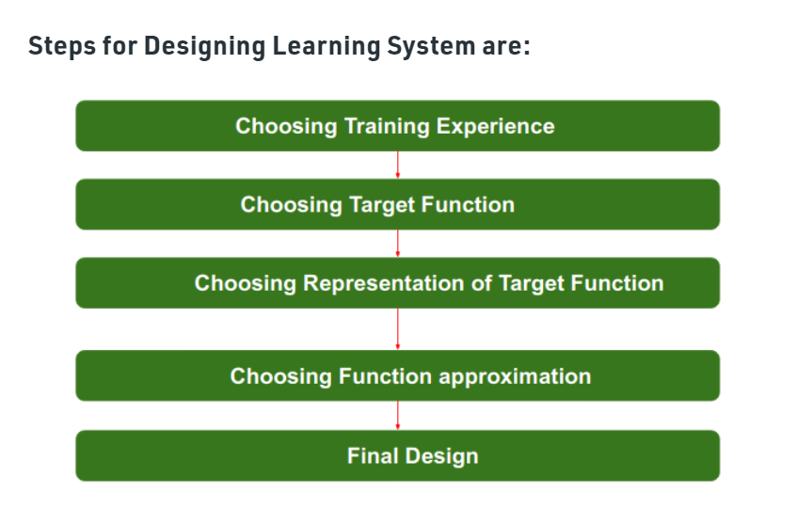

Slide 5
DESIGNING A LEARNING SYSTEM
2. Choosing the Target Function
To determine exactly what type of knowledge will be learned and how this will be used by the performance program.
Let us begin with a checkers-playing program that can generate the legal moves from any board state. The program needs only to learn how to choose the best move from among these legal moves.
Given this setting where we must learn to choose among the legal moves, the most obvious choice for the type of information to be learned is a program, or function, that chooses the best move for any given board state.
Let us call this function ChooseMove and use the notation ChooseMove : B → M to indicate that this function accepts as input any board from the set of legal board states B and produces as output some move from the set of legal moves M.
An alternative target function and one that will turn out to be easier to learn in this setting-is an evaluation function that assigns a numerical score to any given board state.
Let us call this target function V and again use the notation V : B → R to denote that V maps any legal board state from the set B to some real value. We intend for this target function V to assign higher scores to better board states.
Let us therefore define the target value V(b) for an arbitrary board state b in B, as follows:
1. if b is a final board state that is won, then V(b) = 100
2. if b is a final board state that is lost, then V(b) = -100
3. if b is a final board state that is drawn, then V(b) = 0
4. if b is a not a final state in the game, then V(b) = V(b’), where b' is the best final board state that can be achieved starting from b and playing optimally until the end of the game (assuming the opponent plays optimally, as well).

Slide 6

DESIGNING A LEARNING SYSTEM
3. Choosing a Representation for the Target Function
we have specified the ideal target function V, we must choose a representation that the learning program will use to describe the function c that it will learn.
let us choose a simple representation: for any given board state, the function c will be calculated as a linear combination of the following board features:
x1: the number of black pieces on the board
x2: the number of red pieces on the board
x3: the number of black kings on the board
x4: the number of red kings on the board
x5: the number of black pieces threatened by red (i.e., which can be captured on red's next turn)
X6: the number of red pieces threatened by black
Thus, our learning program will represent c(b) as a linear function of the form
where wo through W6 are numerical coefficients, or weights, to be chosen by the learning algorithm.

Slide 7
DESIGNING A LEARNING SYSTEM
Partial design of a checkers learning program:
Task T: playing checkers
Performance measure P: percent of games won in the world tournament
Training experience E: games played against itself
Target function: V:Board →R
Target function representation

Slide 8
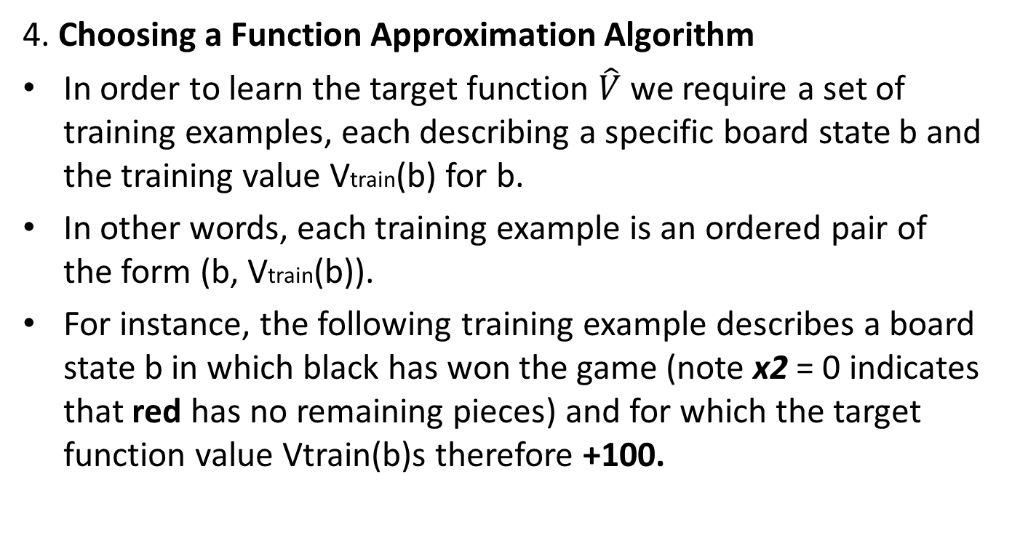
DESIGNING A LEARNING SYSTEM

Slide 9
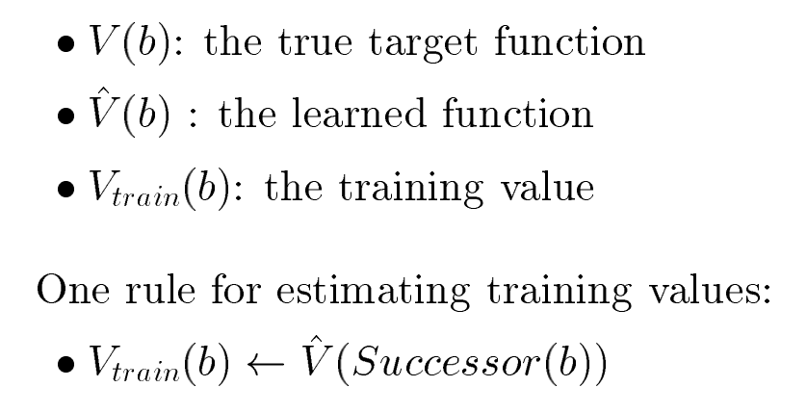
DESIGNING A LEARNING SYSTEM
4.1 ESTIMATING TRAINING VALUES

Slide 10
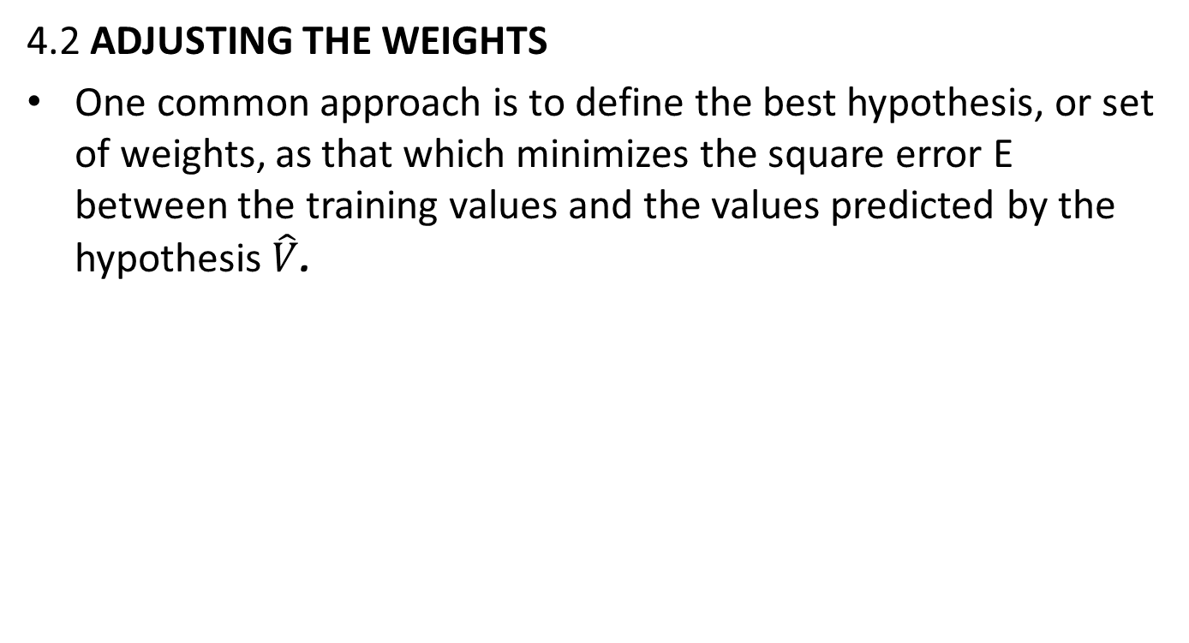

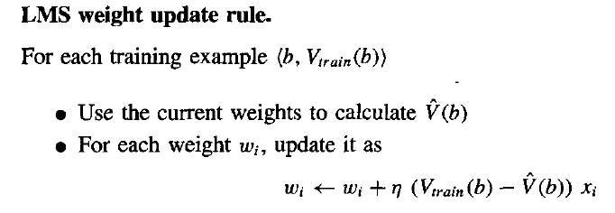
DESIGNING A LEARNING SYSTEM

Slide 11
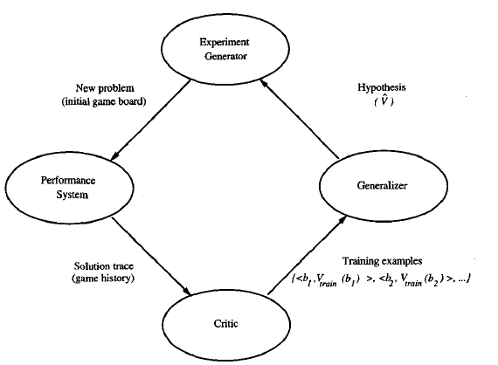
DESIGNING A LEARNING SYSTEM
The Final Design

Slide 12
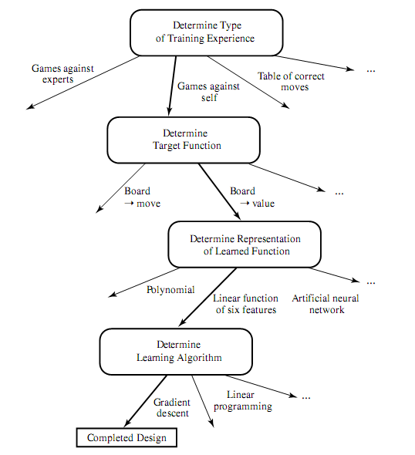
DESIGNING A LEARNING SYSTEM
The Final Design

Slide 13
Exercise
How many steps are involved in building the learning system?
ANS. 7 in ml steps

Slide 14
Exercise
Which of the following is not a step in building a learning system? * Ans. C
Choosing the training experience
Choosing the function approximation algorithm
hyperparameter tuning
None of these

Slide 15
Exercise
Weights are adjusted so that A
Error can be minimized A
Error can be maximized B
Error does not have any relation C

Slide 16
Exercise
Distribution of training examples put impact on the performance of the model. [true]
True
False

Slide 17
Exercise
Explain the designing a learning system of sentiment analysis using neat and clean diagram.
Explain the designing a learning system of Credit card fraud detection using neat and clean diagram.

Slide 18
Thank You !!!

